Slide 1


Omkar Santosh Sugave
7 Jan 2025

Slide 2

Outline
Executive Summary
Introduction
Methodology
Results
Conclusion
Appendix

Slide 3
Executive Summary
Summary of methodologies
Summary of all results

Slide 4
Introduction
Project background and context
Problems you want to find answers

Slide 5

Section 1

Slide 6
Methodology
Executive Summary
Data collection methodology:
As the dataset was been provided by the team so a premade dataset was in hand but that that was made up of various factor like the probalitiy or how many time rocket launch or how many of them failed and considering all the parameter the data was made containing 96 rows.
Perform data wrangling
Firstly data was arranged in proper data type and after that as per the requirement the column were been proseeses for various operation.
Perform exploratory data analysis (EDA) using visualization and SQL
Perform interactive visual analytics using Folium and Plotly Dash
Perform predictive analysis using classification models
How to build, tune, evaluate classification models

Slide 7
Data Collection
Describe how data sets were collected.
You need to present your data collection process use key phrases and flowcharts

Slide 8
Data Collection – SpaceX API
Present your data collection with SpaceX REST calls using key phrases and flowcharts
Add the GitHub URL of the completed SpaceX API calls notebook (must include completed code cell and outcome cell), as an external reference and peer-review purpose
Start
↓
Understand SpaceX API → Identify Key Phrases
↓
Formulate GET Requests with Filters
↓
Make REST API Call → Receive Response
↓
Is Response Valid?
↓ Yes No
→ Extract Relevant Data → Handle Error (Retry/Log)
↓
Format & Save Data (JSON/CSV)
↓
Present Data (Tables, Charts)
↓
End

Slide 9
Data Collection - Scraping
Present your web scraping process using key phrases and flowcharts
Add the GitHub URL of the completed web scraping notebook, as an external reference and peer-review purpose
Start
↓
Define Scraping Objective → Identify Key Phrases
↓
Analyze Website Structure → Choose Scraping Tool
↓
Write Script to Fetch Data
↓
Does Website Allow Scraping?
↓ Yes No
→ Extract Data Handle with Compliance (Robots.txt)
↓
Store Data (CSV/JSON/Database)
↓
Visualize or Analyze Data
↓
End

Slide 10
Data Wrangling
Flowchart
Key Phrases for the Process
Data Cleaning
Data Transformation
Data Integration
Data Enrichment
Start
↓
Load Data (CSV, JSON, API, etc.)
↓
Check Data Quality → Identify Missing or Invalid Values
↓
Clean Data → Handle Missing Values, Remove Duplicates
↓
Transform Data → Filter, Normalize, Aggregate
↓
Integrate Data → Merge, Join Datasets
↓
Enrich Data → Add Calculated Fields, Feature Extraction
↓
Save Processed Data (CSV, Database)
↓
End

Slide 11
EDA with Data Visualization
Various charts are been used in previous modal for showcasing various trends and result of various operation such as
Scatter graph was use for two rows namely flicket ticket and rocket to get trend of the quantity at particular time.
Bar graph were used to show case the various rocket and its success over time
Similarly line graph was also used

Slide 12
EDA with SQL
Data Retrieval:
SELECT * FROM table_name: Fetched all rows from the table.
SELECT column1, column2 FROM table_name: Retrieved specific columns.
Data Filtering:
SELECT * FROM table_name WHERE condition: Filtered rows based on conditions.
Used operators like =, >, <, LIKE, and BETWEEN.
Data Aggregation:
SELECT column, COUNT(*) FROM table_name GROUP BY column: Counted rows grouped by a column.
SELECT AVG(column) FROM table_name: Calculated average values.
SELECT SUM(column) FROM table_name: Summed up values.
Sorting and Limiting:
SELECT * FROM table_name ORDER BY column ASC/DESC: Sorted data.
SELECT * FROM table_name LIMIT n: Retrieved the top n rows.
Joins:
SELECT * FROM table1 JOIN table2 ON table1.column = table2.column: Combined data from multiple tables.
Data Modification:
INSERT INTO table_name (columns) VALUES (values): Inserted new rows.
UPDATE table_name SET column = value WHERE condition: Updated existing rows.

Slide 13
Build an Interactive Map with Folium
Markers: To pinpoint locations and provide detailed, clickable information for better user interactivity.
Circles: To illustrate spatial coverage or impact zones around a point of interest.
Circle Markers: For aesthetically enhanced location markers.
Polylines: To map routes, boundaries, or connections between locations for better visualization.
Polygons: To demarcate and analyze specific regions or areas.
Choropleth Layer: To analyze and communicate spatial patterns or variations in data

Slide 14
Build a Dashboard with Plotly Dash
Plots: To provide a comprehensive view of the data, catering to different analysis needs:
Line and bar charts for trends and comparisons.
Pie charts and histograms for composition and distribution.
Scatter plots and heatmaps for relationships and intensities.
Interactions: To empower users with dynamic exploration capabilities:
Filters and sliders for customizing views.
Tooltips and clickable elements for detailed insights.
Search features for efficient data navigation.

Slide 15
Predictive Analysis (Classification)
Data Preparation:
Collected and cleaned data: Handled missing values, duplicates.
Feature engineering: Created new features, scaled data, and performed encoding.
Split dataset: Divided into training and testing sets.
Model Building:
Chose algorithms: Tried models like Logistic Regression, Decision Tree, Random Forest, etc.
Used libraries: Leveraged scikit-learn for implementation.
Model Evaluation:
Metrics: Evaluated using accuracy, precision, recall, F1 score, and ROC-AUC.
Cross-validation: Ensured stability by splitting training data into folds.
Model Improvement:
Hyperparameter tuning: Performed Grid Search or Random Search.
Feature selection: Removed irrelevant features to reduce noise.
Resampling: Addressed class imbalance using techniques like SMOTE.
Best Model Selection:
Compared metrics: Selected the model with the highest performance across evaluation metrics.
Validated: Ensured generalizability with unseen test data.
[Start]
↓
[Data Preparation] → [Feature Engineering] → [Split Data]
↓
[Build Models] → [Evaluate Using Metrics] → [Tune Hyperparameters]
↓
[Compare Models] → [Select Best Model]
↓
[Validate on Test Data]
↓
[End]

Slide 16
Results
Exploratory data analysis results
Interactive analytics demo in screenshots
Predictive analysis results

Slide 17

Section 2

Slide 18
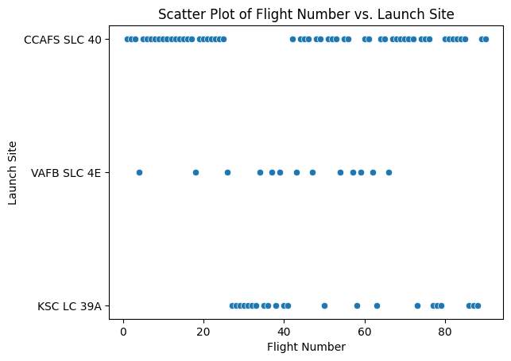
Flight Number vs. Launch Site

Slide 19
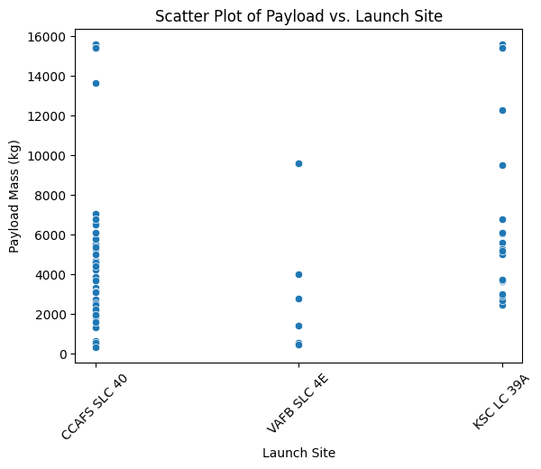
Payload vs. Launch Site

Slide 20
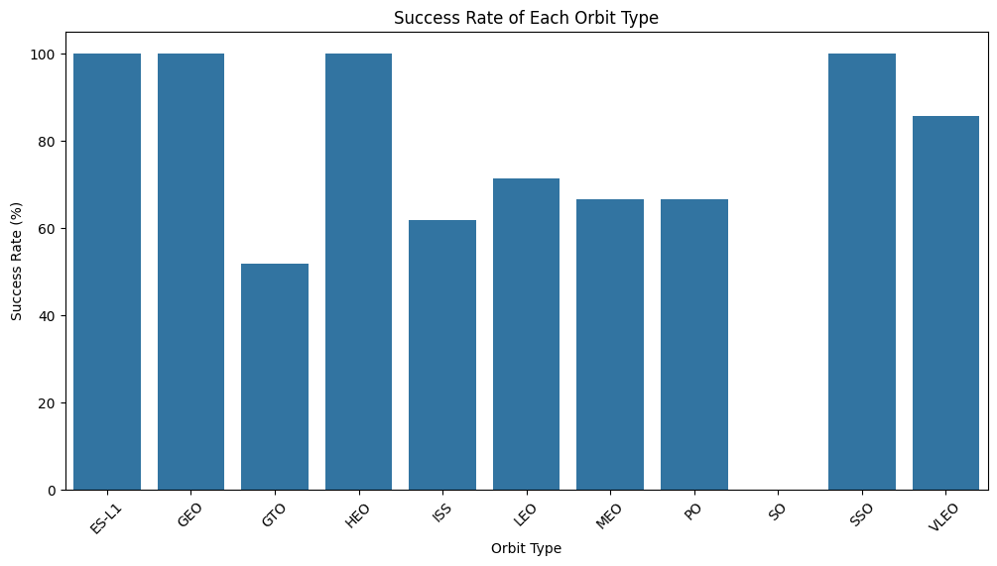
Success Rate vs. Orbit Type

Slide 21
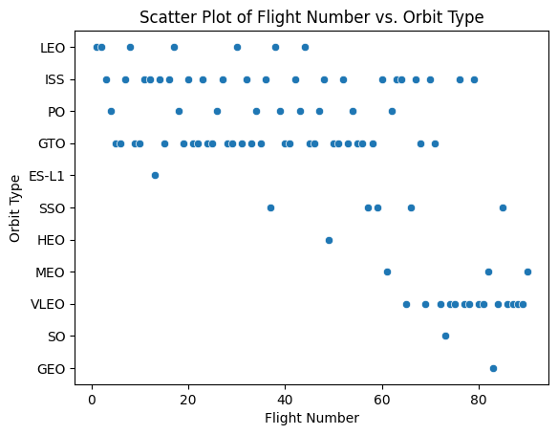
Flight Number vs. Orbit Type

Slide 22
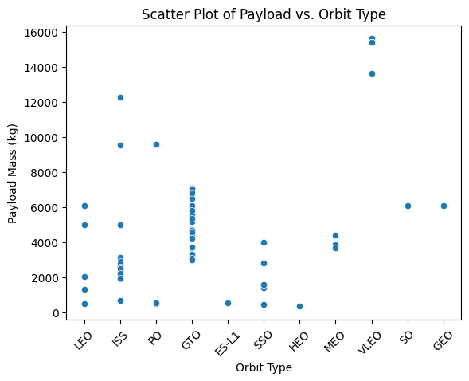
Payload vs. Orbit Type

Slide 23
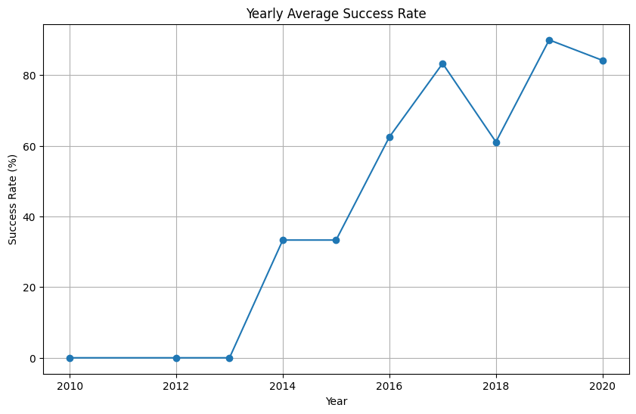
Launch Success Yearly Trend

Slide 24
All Launch Site Names
The unique launch sites in the dataset are:
Cape Canaveral
Vandenberg
Kennedy Space Center
Boca Chica
SELECT DISTINCT: This is used to retrieve unique values from the specified column, in this case, Launch Site.
FROM spacex_data: Refers to the table or dataset containing SpaceX launch information.
This query will return a list of all unique launch sites, ensuring that no duplicate site names are included.
fg

Slide 25
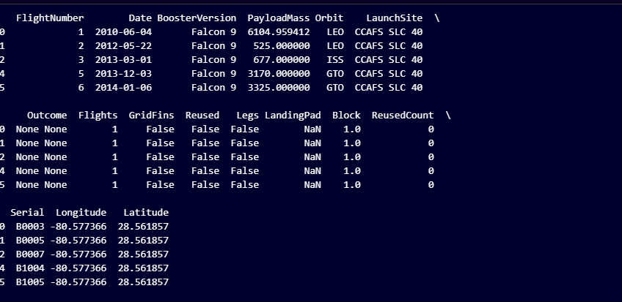
Launch Site Names Begin with 'CCA'
Find 5 records where launch sites begin with `CCA`
Present your query result with a short explanation here

Slide 26
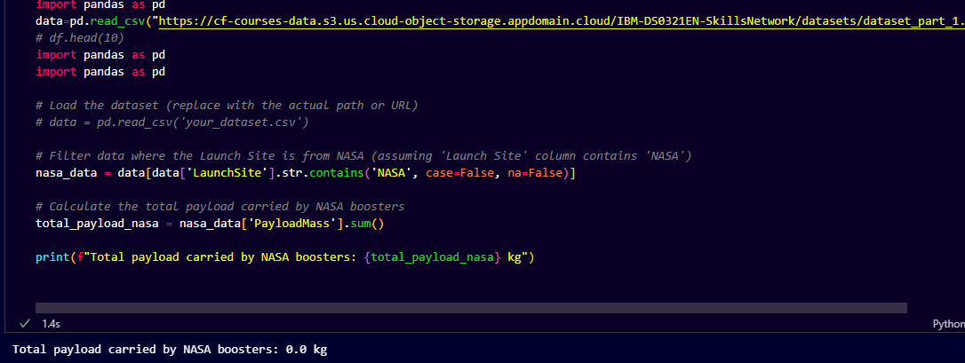
Total Payload Mass

Slide 27
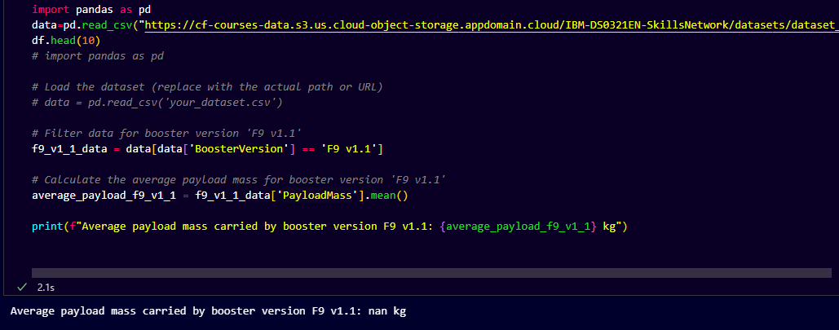
Average Payload Mass by F9 v1.1

Slide 28
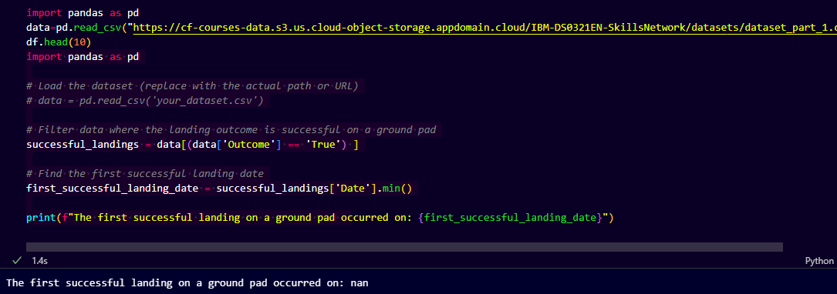
First Successful Ground Landing Date

Slide 29
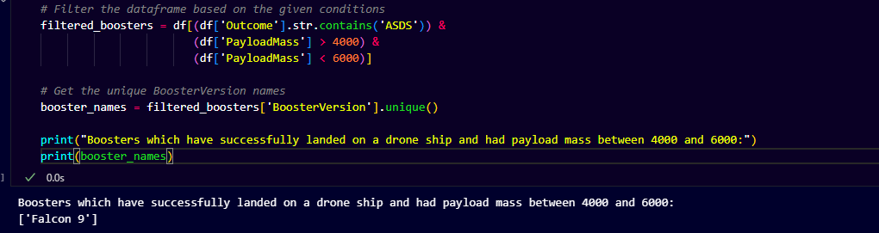
Successful Drone Ship Landing with Payload between 4000 and 6000

Slide 30
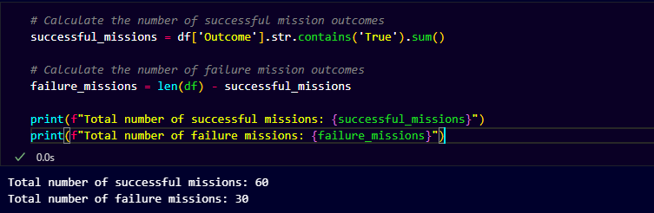
Total Number of Successful and Failure Mission Outcomes

Slide 31
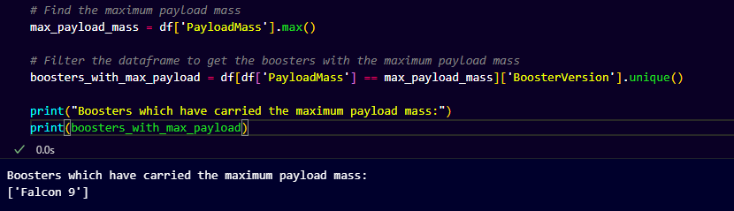
Boosters Carried Maximum Payload

Slide 32
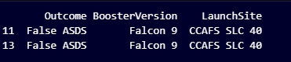
2015 Launch Records

Slide 33
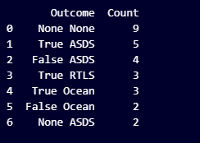
Rank Landing Outcomes Between 2010-06-04 and 2017-03-20

Slide 34

Section 3

Slide 35
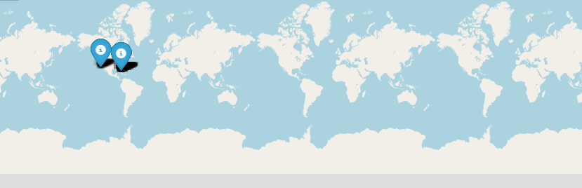
<Folium Map Screenshot 1>
Folium Map : Lauch sites title with an appropriate title
A map showing the different SpaceX launch sites.
Each site will have a marker with details that appear when you click the marker.
Optionally, a circle can highlight the launch area.

Slide 36

<Folium Map Screenshot 2>
Map showing Lauch outcomes
Explore the folium map and make a proper screenshot to show the color-labeled launch outcomes on the map

Slide 37
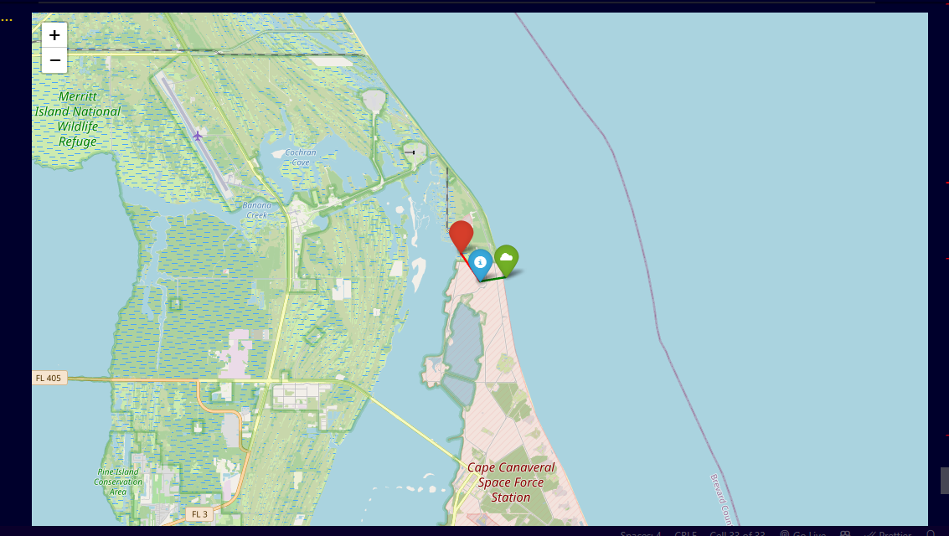
<Folium Map Screenshot 3>
Proximities near launch site
Explore the generated folium map and show the screenshot of a selected launch site to its proximities such as railway, highway, coastline, with distance calculated and displayed
Explain the important elements and findings on the screenshot

Slide 38

Section 5

Slide 39
Classification Accuracy
Visualize the built model accuracy for all built classification models, in a bar chart
Find which model has the highest classification accuracy

Slide 40
Confusion Matrix
Show the confusion matrix of the best performing model with an explanation

Slide 41
Conclusions
Overall we had seen the dataset analytics and visulation behind it ,the data was of the space agency,Data was colleted by both mthod web scarping and using library after which we analyse the various ascpect with graph.
Then we perform data cleaning transform and breakdown various insight fromit using the line graph bar graph etc.
Using foilum map we made proximities analysis of various condition

Slide 42


